Slide 1

2024
CAPSTONE
Bias Beacon
Automated Journalism Bias Detection
Rafael Arbex-Murut, Georgiy Sekretaryuk, Sowmya Chandrasekaran, Yeshwanth Somu

Slide 2
Thought Exercise
How many of you have read the news lately?
Bias Beacon

Slide 3
Thought Exercise
How many of you have read the news lately?
38% of U.S. Adults said they followed the news all or most of the time. 19% follow it now and then. 5% hardly ever (Pew 2022)
Bias Beacon

Slide 4
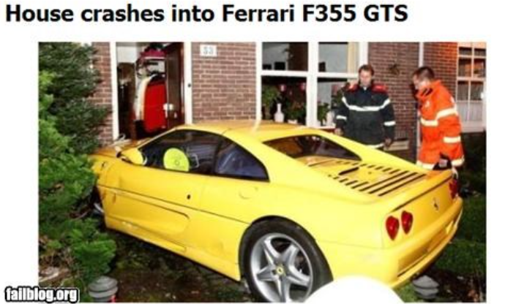
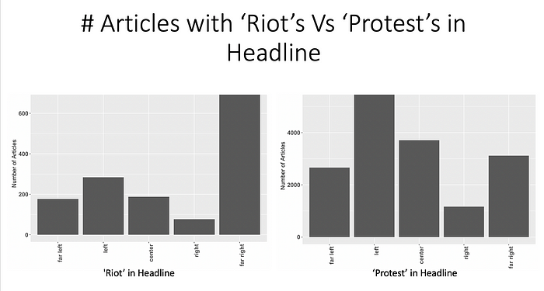
Thought Exercise
How many of you have read the news lately?
38% of U.S. Adults said they followed the news all or most of the time. 19% follow it now and then. 5% hardly ever (Pew 2022)
How many of you have read something that you consider ‘biased’?

Slide 5
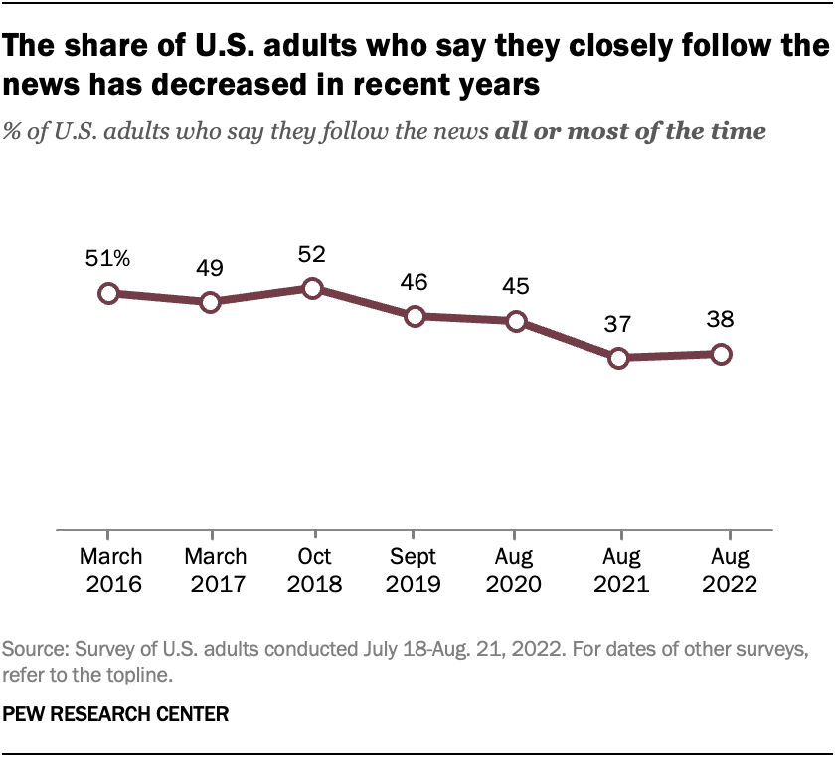
Thought Exercise
How many of you have read the news lately?
38% of U.S. Adults said they followed the news all or most of the time. 19% follow it now and then. 5% hardly ever (Pew 2022)
How many of you have read something that you consider ‘biased’?
What is Happening:
Nearly Half (46%) of all Americans think the media is very biased. (Pew/Knight)
This directly leads to a loss of engagement and trust
Bias Beacon

Slide 6
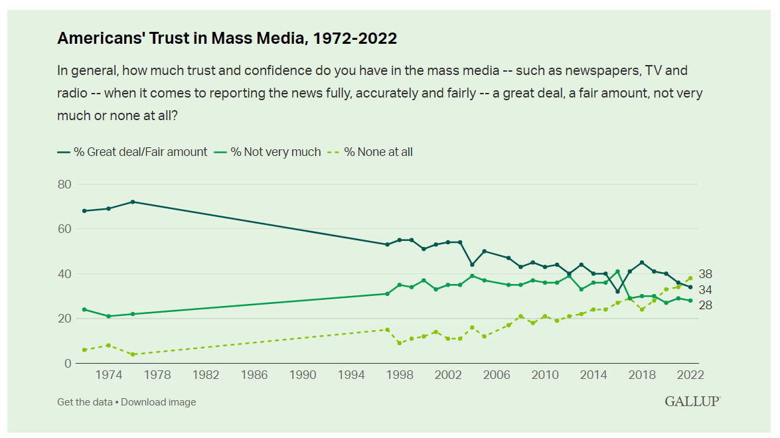
Problem Definition & Impact
The Problem: Media bias has become a crisis, causing people to lose trust in media.
Gallup: Plurality (38%) of U.S. Adults do not trust the media, and steadily declining…
What is the Impact?
Loss of trust in democratic institutions:
Political Polarization (Roscini 2022)
AI-driven misinformation ‘biggest short-term threat to global economy’ (WEF)
Inefficient allocation of resources:
Large financial impacts, cost of fighting misinformation: ~$78 billion
Bias Beacon

Slide 7
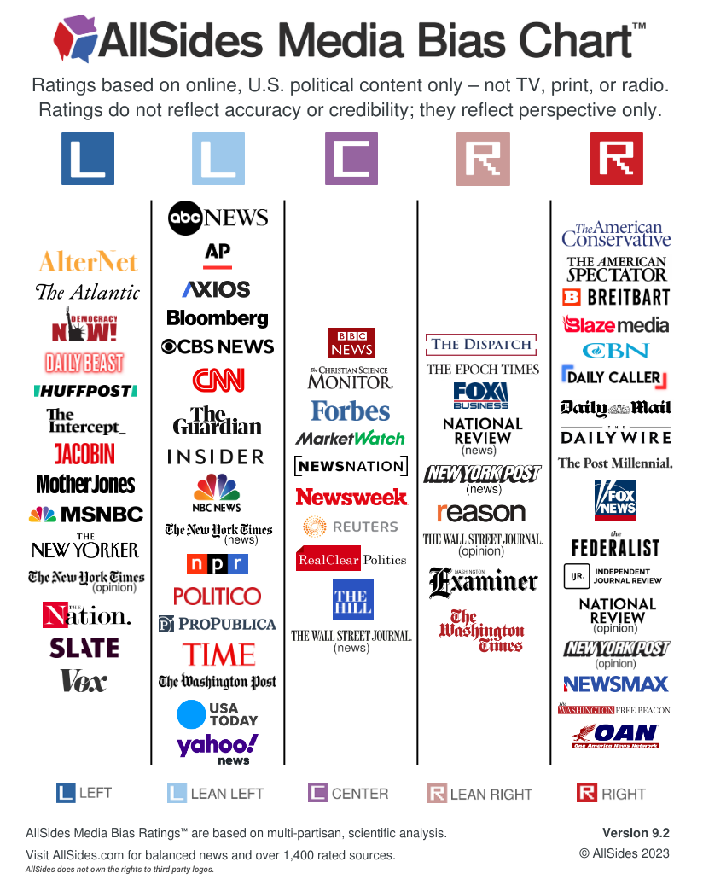
Related Works
Bias has been measured before… but statically.
In academia:
Several studies documenting and measuring bias
Machine-learning media bias (MIT)
In industry:
Websites that measure bias and fact checks.
AllSides, PolitiFact, Snopes, Ad Fontes, etc.
Market Opportunity / Target Users
86% of adults get their news from a digital source (Pew)
Total estimated daily circulation of newspapers (both print and digital) is over 20 million.
Bias Beacon

Slide 8



Our Solution
Our Solution Differs:
Automates bias detection
Removes the need to manually seek out bias rankings
Provides content-level real-time bias detection
Does not make organizational-level assessments (i.e. “The New York Times is…”)
Users no longer have to wait for an article to be fact-checked
Set-and-forget… download once
Native to the most popular media landscape: Digital media
Bias Beacon

Slide 9
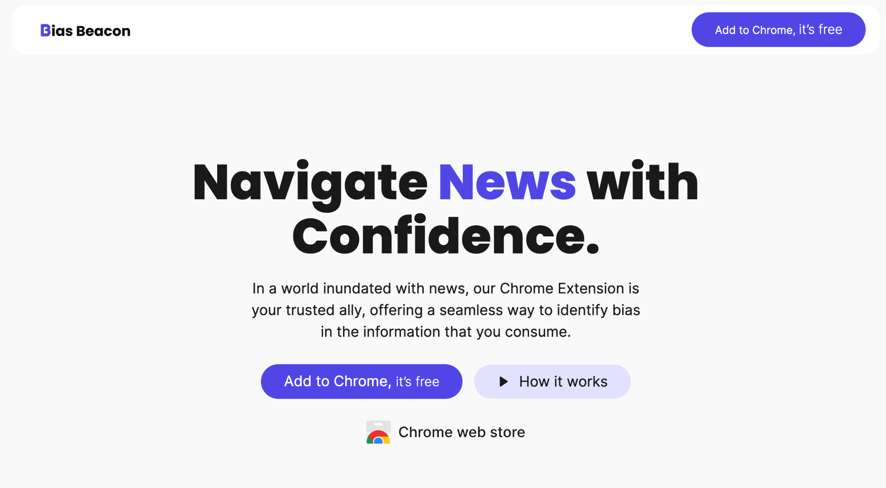
The Solution
A downloadable Google Chrome plugin that identifies biases and informs the readers.
Our Goal: Inform readers to increase literacy / awareness, improve transparency
Bias Beacon
Notes:
DBias accuracy: 0.53
BERT: 0.67
Reduced number of bias labels due to redundancy amongst some
Maybe do clustering on Hate Speech and Gender Bias train encodings to see if there's features in these that are super similar to those of the Racial Bias encodings

Slide 10
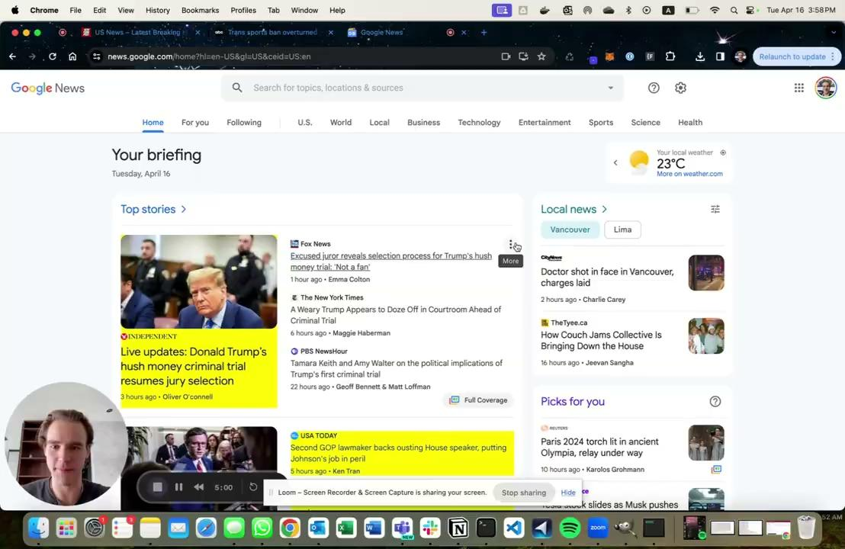
The Solution
Bias Beacon
Notes:
DBias accuracy: 0.53
BERT: 0.67
Reduced number of bias labels due to redundancy amongst some
Maybe do clustering on Hate Speech and Gender Bias train encodings to see if there's features in these that are super similar to those of the Racial Bias encodings

Slide 11





System Architecture
If not in cache, send sentence to AWS.
Indexed Sentence sent to Replit.
Returns bias type and bias score.
Model assesses the bias type and provides a bias score.
Check if site already in cache.
Bias Beacon

Slide 12
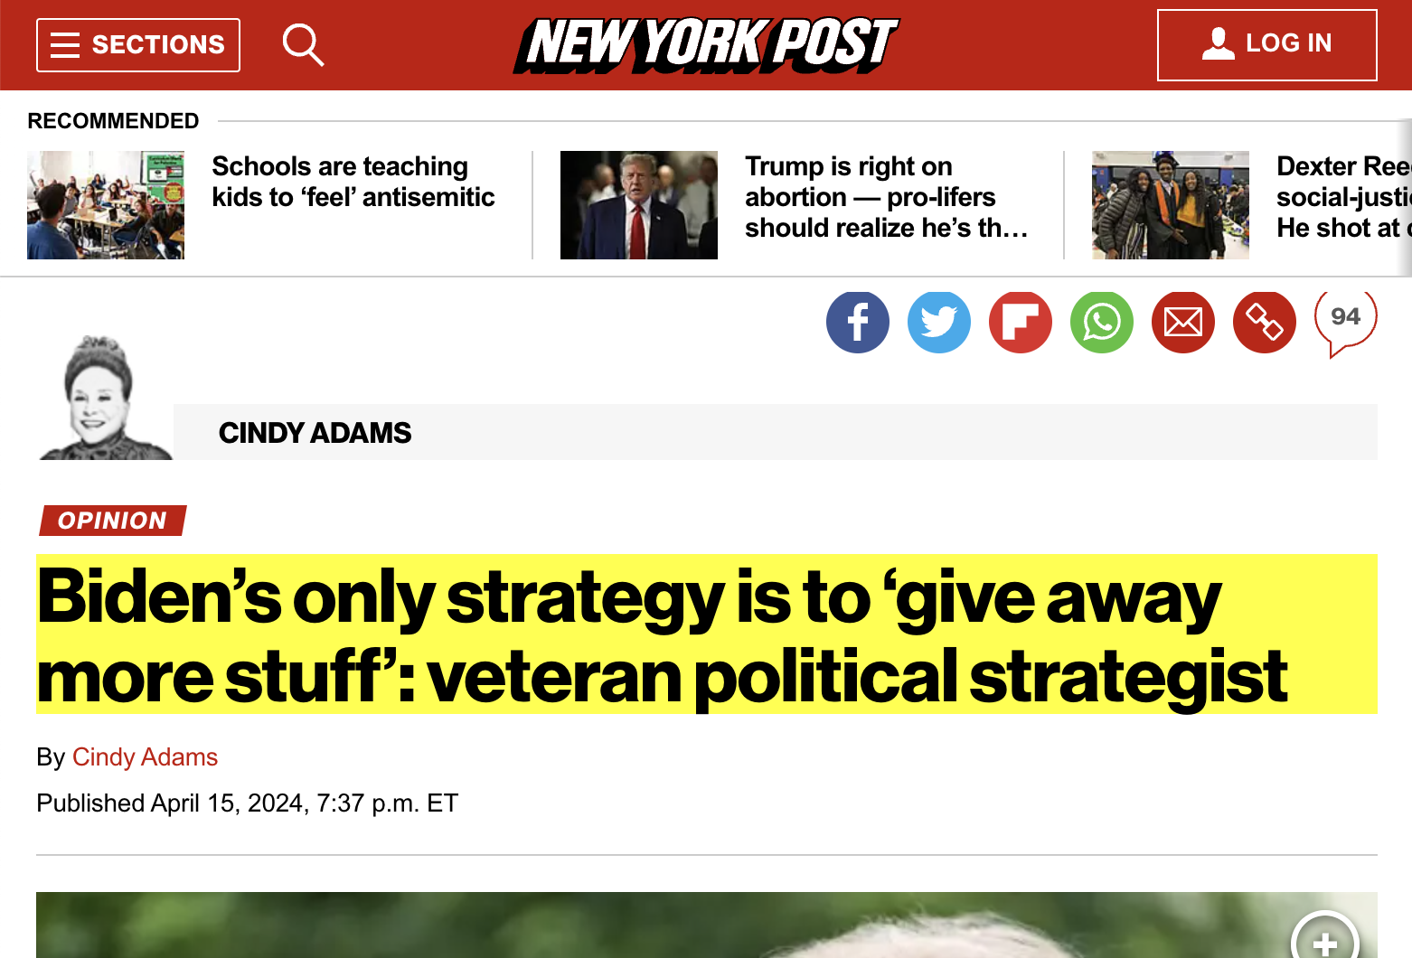
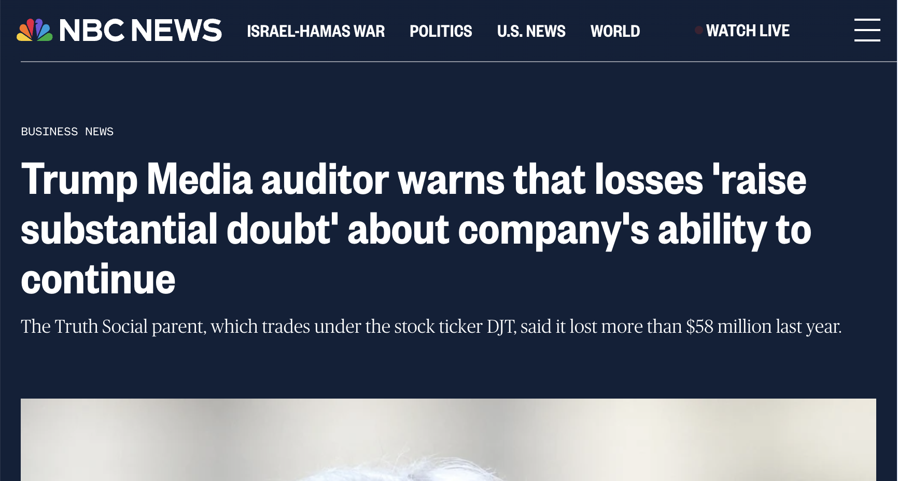
The Solution
Bias highlighted.
No bias detected.
Bias Beacon
Notes:
DBias accuracy: 0.53
BERT: 0.67
Reduced number of bias labels due to redundancy amongst some
Maybe do clustering on Hate Speech and Gender Bias train encodings to see if there's features in these that are super similar to those of the Racial Bias encodings

Slide 13
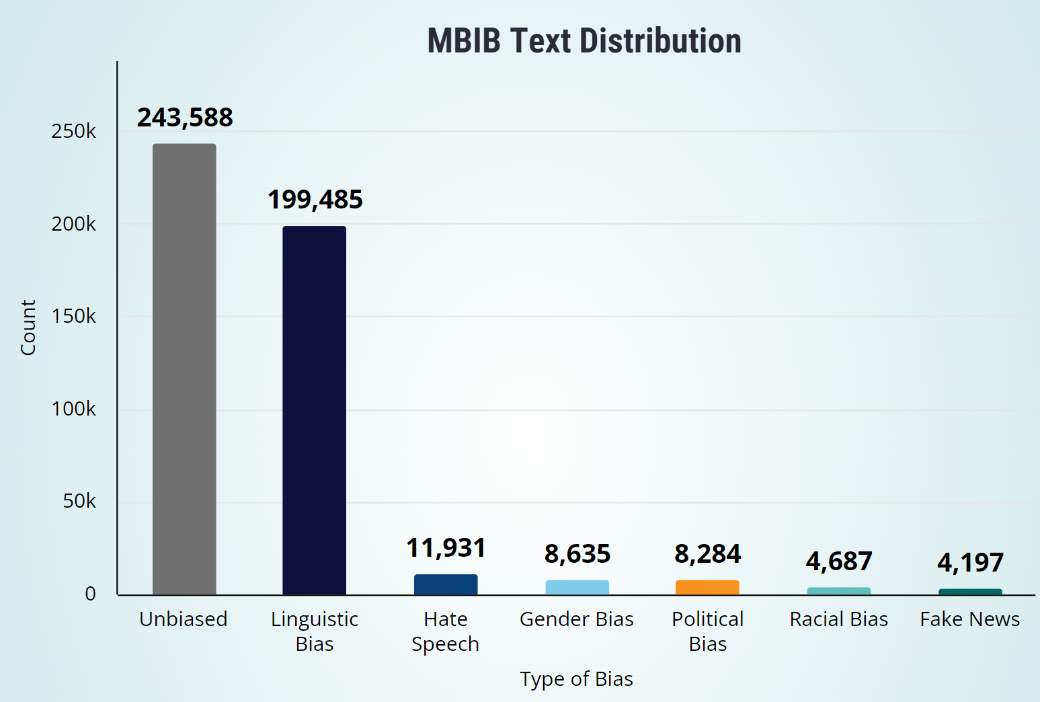
Dataset Exploration - MBIB Dataset
Media Bias Identification Benchmark[MBIB]
Data contains 480,000+ articles, blog posts, Wikipedia articles, etc manually labeled into 6 types of bias
Collected from 22 different data sources
Mixture of individual sentences and paragraphs consisting of sentences
Token length varied from 10 tokens(sentences) to 400 tokens(paragraphs)
Data cleaning to correct grammar and remove article formatting, such as beginning with BREAKING, RT, NEWS
Bias Beacon
Notes:
Slide 13 (Dataset Exploration- MBIB Dataset): The task of classifying bias in text isn’t the most straightforward method. We aimed to use machine learning for this task, for which we needed a dataset containing texts labeled by bias types. We found ourselves limited by the options publicly available, but found some luck with the Media Bias Identification Benchmark.
The MBIB is a text dataset compiled by a group of researchers that aims to group texts into different types of media bias. Comprised of 22 different data sources, this dataset contains 480,000 pieces of text, ranging from 10 token sentences to 400 token paragraphs. They are labeled into different types of biases, which are Linguistic Bias, Hate Speech, Gender Bias, Political Bias, Racial Bias, and Fake News, of which you’ll find the distribution here. Some data cleaning was required to fix grammatical errors and removing any formatting in a paragraph, such as a capital BREAKING at the beginning.
Even though it is the first unified benchmark aimed to classify texts based on bias that we’ve seen, it is not perfect. Here are some examples.

Slide 14
Dataset Exploration Cont.
Text Examples
Fake News: “In the United States alone we lose more than 3,000 people a day to cancer.”
Gender Bias: “I'm just not that into dudes giving me manicures, I like the ladies”
Bad labeling: “but thats because of african americans are uneducated and live in poverty”
Linguistic Bias: “Surprisingly scott seems to admit that this theory is the truth of the matter further admitting that he had even blocked making this decision out of his memory to preserve the fallacy in his own mind and prevent others from discovering his secret.”
Racial Bias: “I think the jews are a intelligent yet sometimes frugal and well adjusted people.”
Political Bias: “Nevertheless President Falwell eagerly uses his national platform to advocate for Donald Trump. While he occasionally clarifies that supporting Trump is not the official position of Liberty University, he knows it is his title of president of the largest Christian university in the world that gives him political credentials.”
Hate Speech: “All americans are bad just like all muslims are terrorist and all black people are criminals.”
Bias Beacon
Notes:
You’ll see here one example per Bias Type, but I’ll only walk through a couple. State the Fake News example. State the Gender Bias example.
Here’s another so-called Gender Bias example… “example” … Even though it doesn’t sound like there’s any Gender Bias in here, it was labeled as such. Similar to this example, there were many other cases of mislabeling. We understood that’s a limitation of the data, as there’s no way to catch all those cases. We nevertheless moved forward with this dataset and proceeded to modeling.

Slide 15

Initial Modeling
Bias Type Prediction and Bias Score
Input Text
Bias Beacon
ChatGPT Icon: https://www.vecteezy.com/vector-art/21608795-chatgpt-logo-chat-gpt-icon-on-green-background
Notes:
Slide 15 (Initial Modeling): Our main goal was to build a model that can take an input sentence, classify it into one of the bias labels with a bias score. The score indicates how much the text leans towards the specific bias it is predicted to be.
We started simple with an out-of-box ChatGPT model to task it with bias classification for a given piece of text.

Slide 16
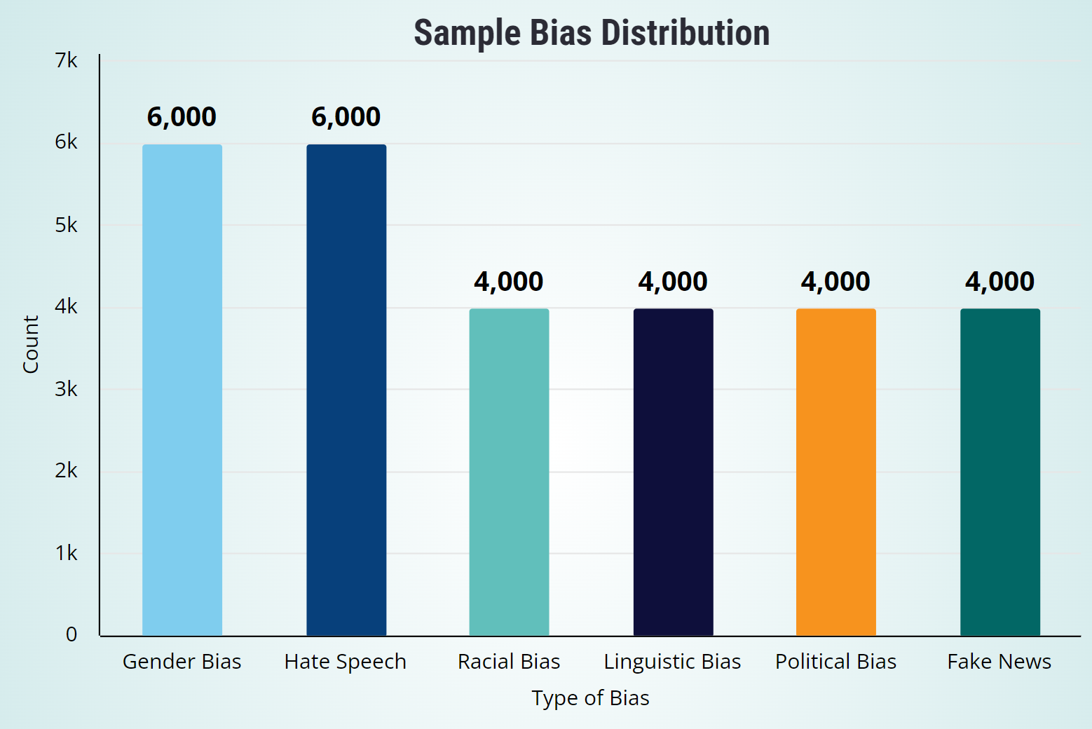
Initial Modeling Cont.
Explored Neural Network architecture
Sampled 28,000 texts for Neural Network model training
Used 60-20-20 train-validation-test split
Bias Beacon
Notes:
Slide 16 (Initial Modeling Cont.): We then moved to a more complex model by training a custom Neural Network on a sample dataset, shown here. 4000-6000 samples were chosen from each label for model training, validation, and testing. We chose to use the accuracy as the initial metric, as it shows how many observations were correctly predicted. This gives a great high-level picture of the model’s performance.

Slide 17
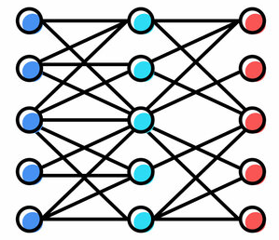
Initial Modeling Results
Accuracy: 40.0%
Accuracy: 54.4%
Bias Beacon
ChatGPT Icon: https://www.vecteezy.com/vector-art/21608795-chatgpt-logo-chat-gpt-icon-on-green-background
Neural Network Icon: https://stock.adobe.com/search?k=neural+network+icon&asset_id=490345560
Notes:
Slide 17 (Initial Modeling Results): We found that neither of these models performed well, as the GPT and Neural Network models had test accuracies of 40% and 54.5%. We moved onto a very popular and familiar model, used widely in the industry, called the BERT model. We chose BERT because it is very accurate in multi-class prediction and can handle a large amount of input tokens.

Slide 18
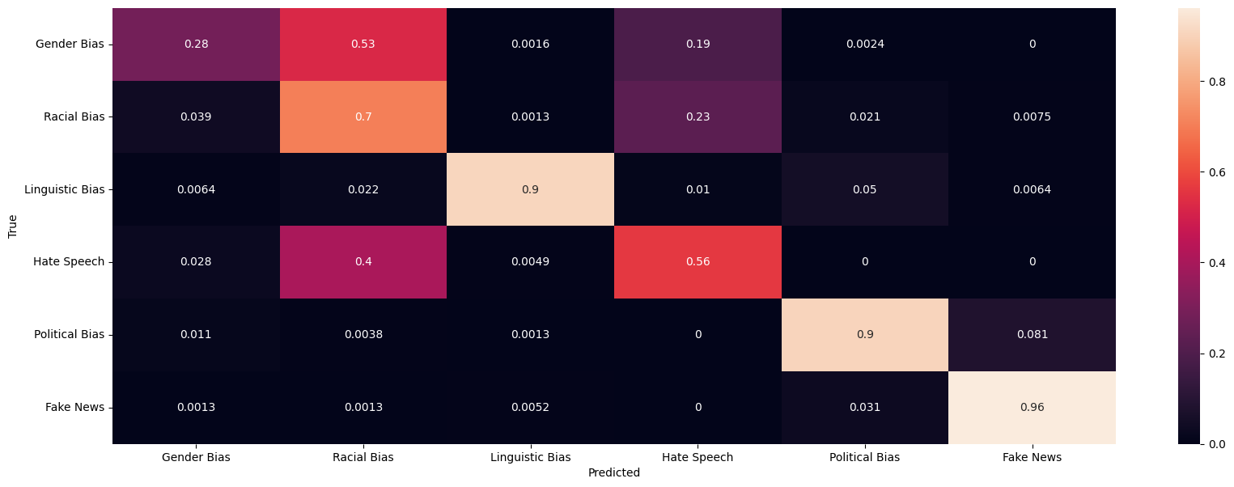
Model Performance - BERT
Accuracy
69.2%
Macro averaged F1
72.1%
Bias Type | F1 Score
Gender Bias | 43.7%
Racial Bias | 45.7%
Linguistic Bias | 95.1%
Hate Speech | 60.5%
Political Bias | 92.6%
Fake News | 95.3%
Bias Beacon
Notes:
Slide 18 (Modeling Performance - BERT): After training and testing the BERT model on the same sets used for the Neural Network, we observed an accuracy of 69.2%, with a Macro averaged F1 score of 72.1%. It was clear that BERT was the best option among these three options due to the high accuracy and F1 score.
In the confusion matrix, it is seen that the model performed very well with Linguistic Bias, Political Bias, Fake News, and even Racial Bias.
However, it often confused Gender Bias with Racial Bias or Hate Speech.
We recognized that Gender Bias and Racial Bias are forms of Hate Speech, which we believe led to the misclassifications, which we can take a look at now.

Slide 19
Model Performance - Classifications
“im pretty sure most of the parents on dance moms are southern right wingers”
Predicted as Racial Bias but in reality, it has tendencies of Gender Bias
“practicing jew here a lot of jews are conservative its just loud new york twitter jews who get the coverage any jew with a brain would never vote democrat”
Predicted as Hate Speech but in reality, it is specifically Racial Bias
Bias Beacon
Notes:
Slide 19 (BERT model misclassifications)
Talk about the model misclassifications
Transition: “We realize that our model isn’t perfect, and misclassifications are inevitable. To understand what that means from an ethics and privacy standpoint, I’ll hand it over to Sowmya.”

Slide 20
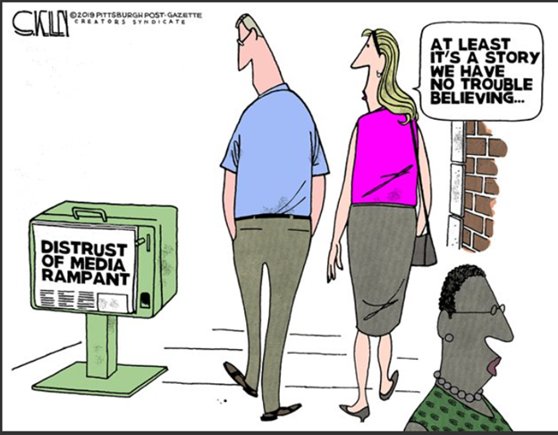
Discussion
Ethics:
Altering media content is a sensitive topic: how do we know the altered version isn’t biased itself?
Essential to be mindful of how dataset was accumulated
Privacy:
Several privacy concerns exist regarding plug-in installation:
A study showed 51% of all installed extensions were high risk and had the potential to cause extensive damage
Developers of Chrome extensions in the Web Store need to certify their privacy practices and data use.
Bias Beacon
7/7

Slide 21
Conclusion and Lessons Learned
Closing Thoughts:
As bias and disinformation increase, users will need tools to help navigate media content
With a large amount of news consumers and the low trust levels, there is a huge market for media bias detection tools
Bias Beacon is a plug-in that users can install to understand bias in the headlines of articles read
It not only detected bias in headlines, but further specifies the type of bias detected
Lessons Learned:
Important to consider end-user throughout the tool development process
Helpful to have initial assumptions challenged
Learned a lot about how plugins are developed
If we had more time:
Refine Data, establish CI/CD pipeline
Improve unsupervised model
Mobile application
Bias Beacon
7/7
Notes:
DBias results aren't what we hoped.
We will use an ensemble model of different models, collect user feedback, and continuously revise/retrain the models to improve performance.
User feedback is really what's going to help improve the model performance (MBIB/??? are only 2 limited datasets, need more diverse training, more labeling, etc etc)

Slide 22
2024
CAPSTONE
Thank you!
We'd be happy to answer any questions that you have.
Rafael Arbex-Murut, Georgiy Sekretaryuk, Sowmya Chandrasekaran, Yeshwanth Somu
End.

Slide 23
Sources
Pew:
https://www.pewresearch.org/short-reads/2023/10/24/americans-are-following-the-news-less-closely-than-they-used-to/
Pew/Knight:
https://knightfoundation.org/press/releases/gallup-knight-poll-americans-concerns-about-media-bias-deepen-even-as-they-see-it-as-vital-for-democracy/#:~:text=The%20results%20of%20the%202020,is%20most%20pronounced%20among%20Republicans.
Boston University:
https://sites.bu.edu/pardeeatlas/advancing-human-progress-initiative/back2school/how-the-american-media-landscape-is-polarizing-the-country/#_ftn5
MBIB
https://media-bias-research.org/wp-content/uploads/2023/04/Wessel2023Preprint.pdf
Bias Beacon
7/7
Notes:
DBias results aren't what we hoped.
We will use an ensemble model of different models, collect user feedback, and continuously revise/retrain the models to improve performance.
User feedback is really what's going to help improve the model performance (MBIB/??? are only 2 limited datasets, need more diverse training, more labeling, etc etc)

